Slide 1
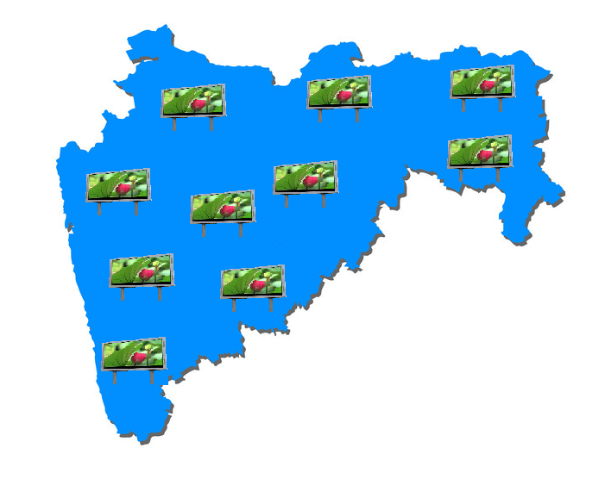

LED Communication Network

Slide 2
Introduction – Pentagon Automation Concepts
Pentagon Automation Concepts specialize in the installation, maintenance and servicing a wide range of signage, security & automation systems, having major experience in communication & security landscape.
Currently there are 17 District hospitals with 100+ beds and resident colleges, where there is a need to install a mass communication media for general public information on the facilities & services offered by the hospital & college together.
We aim to implement a network of LED screens across all the hospitals to benefit the 5000+ daily visitors, who arrive at each of these facilities.
Along with providing latest information for all visitors of the facility, the LED network will also assist as a revenue generation platform.

Slide 3
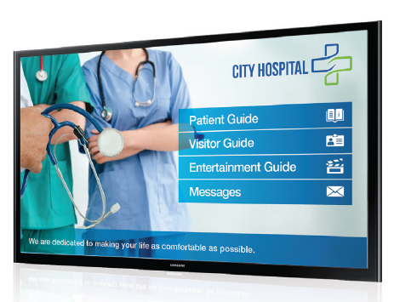
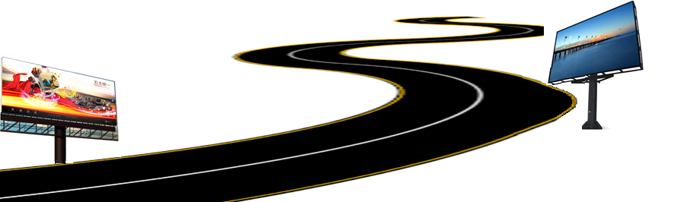
Executive Summary
The objective of this presentation is to propose building a state-wide infrastructure of mass communication, provisioned via network of LED-wall based point of displays (POD), installed across Maharashtra government hospitals with resident medical colleges.
Through the course of this presentation, we aspire to demonstrate how the best in class & multi-purpose visual media displays would provide a variety of flexible benefits to the Ministry of Public Health, Maharashtra.
We are experienced in communication programs with proficiency in brand planning, creative development, media & even planning and digital integration.
Through the course of this presentation, we aspire to demonstrate how the best in

Slide 4

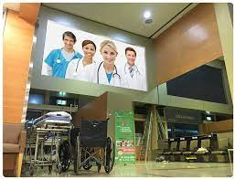
Body of Work
Installation of 18x12ft LED Point of Displays (POD) at district hospital with resident medical colleges.
All existing 17 hospitals with resident colleges to be equipped with the PODs, with additional flexibility to promptly install screens on other or new hospitals too.
This concept is seamlessly extensible to urban corporate & commercial promotion infrastructure setup & management too.
POD will be designed to play video streams, motion pictures, still images & scrolling text and will be installed on top of 18-20 feet high platform, for clear visibility upto 150 meters.
All PODs will be centrally managed from a control room, with recovery systems for business continuity during any unplanned outages.

Slide 5
Details of Hardware
Bigger column diameter - 200 mm, Smaller column diameter - 150 mm
Both columns will be connected by flanges
Final column will be mounted on concrete base by anchor bolts
Column will be supported by two C-channel from opposite sides to cater for wind load
C- channel frame will be mounted on top of column to support digital board
3 column supports are required for 12ft x 18ft advertising board
Oil & Radium painted surface finish (All seasons + night vision + lifespan 10 years)
Artefact | Period
Fabrication | 2 Days
Installation | 1 Day
Foundation | 4 Days
Phase 1 implementation (150 locations) | < 100 Days

Slide 6
Installation of Hardware and Software
LED Grid display will be integrated with a controller which will be attached to a processor which will run the software for the content of desired choice.
Processor will have a internet connectivity which will upload the content to the desired location, content will be software driven.
Software will have the ability to change the content from the control room. It will have flexibility to dynamically display the content automatically, during required timings.
Content will be designed in such a way that the commuter will be able to view it from a distance of about 150 meters.
Power backup can be provided by diesel generator & surpassed with UPS of correct wattage.
Bespoke software to run on all standalone systems powered through a powerful quad core processor to play media.
Software WILL be remotely operated on for individual machines or mobile applications and will be broadcasted to all PODs across India through internet connectivity.

Slide 7
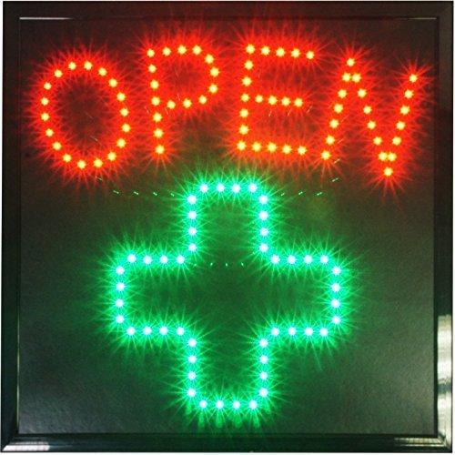
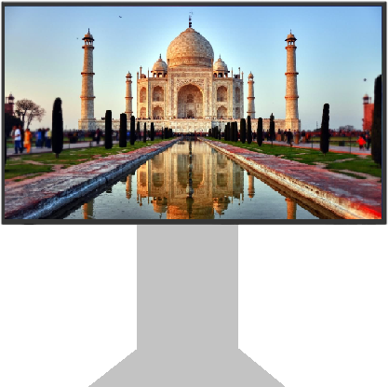


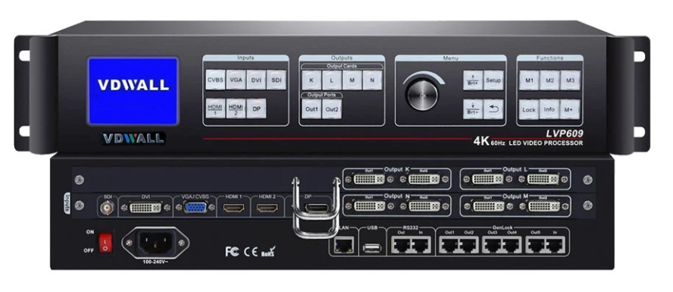
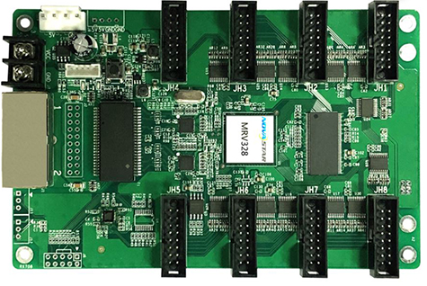
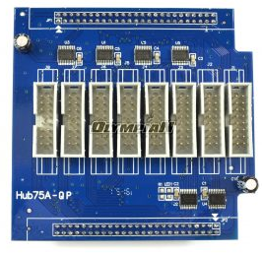



End to End Infrastructure
POD
Video Processor &
Application Software
Receiving
Card
Sending
Card
Control System
Power Distribution

Slide 8





Value Proposition
Mass communication
Instrument, with daily reach to over 85000 visitors
Broadcast in local language, allowing communication to reach wide range of audience
Emergency communications
can be displayed for public awareness in extreme incidents like natural disaster, fire, pandemic etc.
Location specific broadcast
allowing most relevant communication to reach local residents
10% time allotment to MoHFW of the transmission time for dedicated broadcast on facilities, status, availability, natural disaster, pandemic information etc.
Immediate broadcast
of message across media channels like video, image, text etc.

Slide 9
Value added features
The idea behind the installation of the large screen at at every college hospital will to be to create a visual awareness for the visitors in different facets of life and allow us many opportunities as:
Government advertisements & campaigns
Hospital facilities & department locations
Dedicated support to MoHFW communications
Safety standards & PPE SOPs
Public messages & crisis communications
Sponsored advertisements
Various aspects of safety & precautions
Health tips & locality information
Expedited information sharing & disaster communications e.g., pandemic, critical services etc.
Software will be bespoke and smartly designed to centrally manage media content to be broadcasted on pan-India screens & monitored from same central hub
All changes will be centrally managed & communicated remotely via the hub

Slide 10
LED Tech Specs:
S. NO. | Artefact | Description | Configuration
1 | Model | FS 10/12 | 10-12mm Pixel Pitch
2 | Physical Density | 10-12k dot/m2
3 | LED Config | 1R1G1B | SMD3535
4 | Module Size | 320x160 | 32x16 pixels
5 | Drive Mode | 1/4 Constant Current Drive
6 | Viewing Angle (Deg) | H140/V140 | Brightness 5500
7 | Grey Scale | 16 bits | Refresh rate 1920
8 | Cabinet Resolution | 96x96 Pixels | Weight 50 KG
9 | Power Consumption (W/m2) | Max: 750 / AvG : 250
10 | Cabinet Material | Iron / Aluminium | Color >16.7
11 | Input Voltage | 110-220V AC (+/- 10%) | IP65 Protection
12 | Refresh Frequency | 60HZ
13 | Humidity Support | 10-95% | Temp: -30 to +60
14 | Certificates | CCC, CE, R0HS

Slide 11

Project Plan & Duration
4
Phase 3: 3 months
POD installation on final 8 locations
Beta Testing & Handover – Q4 2022
AMC commencement
3
Phase 2: 3 months
POD installation at 6 locations
Beta Testing – Q3 2022
2
Phase 1: 3 months
POD installation at 3 locations
Beta Testing – Q2 2022
1
Project Approval and Commencement
Q1 2022

Slide 12
MoHFW Support
To accelerate implementation of this program, a support model is also requested MoHFW, as:
POD installation space at all 17 college hospitals
20KVA electricity supply line (to be paid for & maintained by project team)
POD & electricity line access to AMC contract vendor for maintenance purposes
Lease term of 9 years

Slide 13

Q & A

